Slide 1
Scholarship Merit Badge
Troop 344 and 9344
Pemberville, OH

Slide 2
Scholarship Merit Badge Requirements
Do ONE of the following:
Show that your school grades have been an average of B or higher (80 percent or higher) for one term or semester.
Show that for one term or semester you have improved your school grades over the previous period.

Slide 3
Scholarship Merit Badge Requirements
Do TWO of the following:
Make a list of educational places located where you live (other than schools). Visit one, and report on how you used the place for self-education.
With your counselor's and your parent's approval, interview two professionals (other than teachers or other professionals at your school) with established careers. Find out where they were educated, what training they received, and how their education and training have helped prepare them for the career they have chosen. Find out how they continue to educate themselves. Discuss what you find out with your counselor.
Using a daily planner, show your counselor how you keep track of assignments and activities, and discuss how you manage your time.
Discuss the advantages and disadvantages of the different methods of research available to you for school assignments, such as the library, books and periodicals, and the Internet.

Slide 4
Scholarship Merit Badge Requirements
Get a note from the principal of your school (or another school official named by the principal) that states that during the past year your behavior, leadership, and service have been satisfactory. If you are home-schooled or your school environment does not include a principal, you may obtain a note from a counterpart such as your parent.
Do ONE of the following:
Show that you have taken part in an extracurricular school activity, and discuss with your counselor the benefits of participation and what you learned about the importance of teamwork.
Discuss your participation in a school project during the past semester where you were a part of a team. Tell about the positive contributions you made to the team and the project.

Slide 5
Scholarship Merit Badge Requirements
Do ONE of the following:
Write a report of 250 to 300 words about how the education you receive in school will be of value to you in the future and how you will continue to educate yourself in the future.
Write a report of 250 to 300 words about two careers that interest you and how specific classes and good scholarship in general will help you achieve your career goals.

Slide 6
Requirement 1
Do ONE of the following:
Show that your school grades have been an average of B or higher (80 percent or higher) for one term or semester.
Show that for one term or semester you have improved your school grades over the previous period.

Slide 7
Requirement 2
Do TWO of the following:
Make a list of educational places located where you live (other than schools). Visit one, and report on how you used the place for self-education.
With your counselor's and your parent's approval, interview two professionals (other than teachers or other professionals at your school) with established careers. Find out where they were educated, what training they received, and how their education and training have helped prepare them for the career they have chosen. Find out how they continue to educate themselves. Discuss what you find out with your counselor.
Using a daily planner, show your counselor how you keep track of assignments and activities, and discuss how you manage your time.
Discuss the advantages and disadvantages of the different methods of research available to you for school assignments, such as the library, books and periodicals, and the Internet.

Slide 8
2a. Educational Places
Toledo Zoo & Aquarium 2 Hippo Way, Toledo, OH 43609 (419)385-5721
Imagination Station 1 Discovery Way, Toledo, OH 43604 (419)224-2674
Toledo Museum of Art 2445 Monroe Street, Toledo, OH 43620 (419)255-8000
Toledo Botanical Garden 5403 Elmer Drive, Toledo, OH 43615 (419)536-5566
Oak Openings Preserve 4139 Girdham Road, Swanton, OH 43558 (419)360-9179
Fort Meigs 29100 W. River Rd, Perrysburg, OH 43551 (419)874-4121
Fossil Park 5675 Centennial Road, Sylvania, OH (419)882-8313
The Toledo Symphony Orchestra 1838 Parkwood Ave., Toledo, OH 43604 (419)246-8000
National Museum of the Great Lakes 1701 Front Street, Toledo, OH 43605 (419)214-5000
BGSU Planetarium Website (419) 372-2421
Big Fab Lab 1234 N. Main St. Bowling Green, Ohio 43402 (419) 971-4244
Carter Historic Farm 401 Campbell Hill Road Bowling Green, Ohio 43402 (419) 354-6223
National Construction Equipment Museum 16623 Liberty Hi Road Bowling Green, Ohio 43402 (419) 352-5616
Wood County Historical Center and Museum 13660 County Home Road Bowling Green, Ohio 43402 (419) 352- 0967

Slide 9
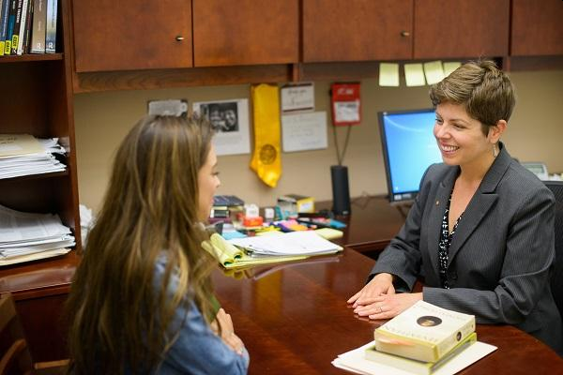
2b. Interviews
Interview two professionals (other than teachers or other professionals at your school) with established careers.
Find out where they were educated, what training they received, and how their education and training have helped prepare them for the career they have chosen.
Find out how they continue to educate themselves.

Slide 10
2c. Daily Planner

Slide 11
2d. Research Methods
Library Advantages
Uses universal cataloging systems that classify and organize all resources.
There are many different information sources in one location
Free internet access
You can take books home which is more convenient.
Has knowledgeable librarians to help you locate resources.
Often has archived materials—newspapers and magazines—that date back many years.
Provides free access to journals, magazines, newspapers, encyclopedias, and other print reference works.
Library Disadvantages
Resources can be checked out by other patrons and, therefore, may not always be available.
A library's publications cannot provide up-to-the-minute news and information the way Web sites can.
You cannot check out reference books
Closes after hours.

Slide 12
2d. Research Methods
Books and Periodicals Advantages
Thorough overview of a topic.
Quality checked by publisher.
Usually well-researched.
Include references to other sources you can use.
Books and Periodicals Disadvantages
Because it can take years to write and publish books they are not always the best sources for current topic.
Scholarly journals include information of academic interest, so they are not the best sources for general interest topics.

Slide 13
2d. Research Methods
Internet Advantages
They're familiar, easy to search and use
Online resources can be accessed 24 hours a day, 7 days a week.
Great sources for background information on a subject or topic overviews
Great for finding recent, local, or personal information such as current news, government information, organizations, opinions, personal stories, and more
Tons of information, usually freely available to you.
Provides access to many newspapers, magazines, journals, and encyclopedias.
Web sites can be constantly updated to provide breaking news and timely information.
Internet Disadvantages
Has no system that catalogs and organizes all resources.
The internet is full of advertising and paywalls
There's no quality control; anyone can create content, and it's often hard to figure out where information came from
Top search results are often paid for; you may not be seeing the whole picture
There's misinformation and “fake news” to dig through, so you need to spend more time judging the credibility of sources.
Some electronic resources are only available through a subscription.
Does not have knowledgeable librarians who can help you find resources.

Slide 14
Requirement 3
Get a note from the principal of your school (or another school official named by the principal) that states that during the past year your behavior, leadership, and service have been satisfactory. If you are home-schooled or your school environment does not include a principal, you may obtain a note from a counterpart such as your parent.

Slide 15
Requirement 4
Do ONE of the following:
Show that you have taken part in an extracurricular school activity, and discuss with your counselor the benefits of participation and what you learned about the importance of teamwork.
Discuss your participation in a school project during the past semester where you were a part of a team. Tell about the positive contributions you made to the team and the project.

Slide 16
4a. Extracurricular Activities
Benefits of extracurricular activities
Improved Academic Performance - students who participate in them typically have higher grades, more positive attitudes toward school and higher academic aspirations.
Explore Interests and Create Broader Perspectives - When you participate in multiple different activities, you’ll get the opportunity to explore a range of interests and unlock passions you never knew you had!
Higher Self-esteem - The more you achieve success through activities you’re passionate about, the more your self confidence will improve.
Social Opportunities - one of the easiest ways to make friends is through extracurricular activities!
Productive Breaks - Extracurricular activities give you something fun to do aside from school.

Slide 17
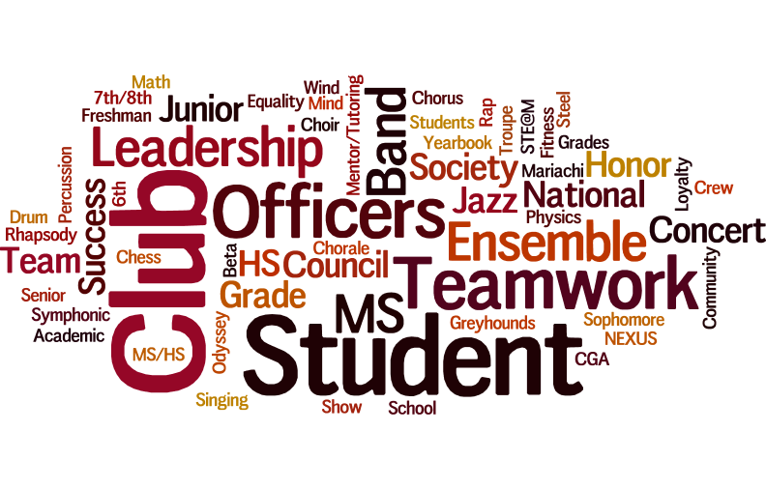
4a. Extracurricular Activities
Benefits of extracurricular activities (continued)
Essential Life Skills - one of the greatest advantages extracurricular activities give you are “real world” skills.
These skills include (but are not limited to):
Goal setting
Teamwork
Time management
Prioritizing
Problem solving
Analytical thinking
Leadership
Public speaking
Resumes - Without much previous work experience, one of the only ways hiring managers can assess your ability and work ethic is through your extracurricular activities.
University Applications - Universities want to see that you’ve gone above and beyond in your intended area of study and have made a difference and/or excelled your field.

Slide 18
4a. Extracurricular Activities
The Importance of Teamwork
Teaches essential social skills.
Teamwork teaches essential communication and social skills, such as active listening and effective speaking.
When working as a team, students learn how to listen to their leaders and coaches in order to perform their individual roles. Students learn how to listen to one another in order to function as a cohesive unit.
Teamwork teaches students how to respectfully and confidently express their ideas and opinions effectively in a group setting.
It’s important for students to recognize that speaking is not the same as talking. Speaking is about understanding how to communicate with an audience.
The way in which a student speaks to other group members demonstrates her level of understanding and respect for others.
Improves self-confidence.
Teamwork teaches students that their voices are respected and valued.
Knowing that she will be heard helps build a student’s self-confidence, while encouraging further participation in group activities.
This becomes a self-sustaining cycle: participation in team activities teaches students how to be better communicators, which in turn helps every member of the team feel valued and respected.
As a result, even the most introverted and quietest members of the team can become active participants and learn to enjoy team activities.

Slide 19
4a. Extracurricular Activities
The Importance of Teamwork (continued)
Reduces bullying.
One of the biggest benefits of teamwork is its potential to dramatically reduce the effects of bullying on students.
When a student knows she is valued and respected by others, she will be able to rise above the hurtful acts or comments of a bully.
Being a part of a team that genuinely cares about its members will also give a student a strong support system.
Ultimately, team members tend to stick together outside of collaborative settings (like sports practice and clubs), which means they can support one another in challenging settings.
Furthermore, the self-confidence from team activities may empower a student to stand up for other victims of bullying who may not have a similar support system.
Sets students up for future success.
The benefits of teamwork almost always translate into success outside the classroom.
There are very few career paths that operate in isolation. As an employee in almost any industry, people are required to work closely with others.
That’s why employers prefer to hire people who have demonstrated their ability to work as a part of a team.
Introducing students to collaborative environments early in their school experiences presents opportunities for them to more productive and joyful as they work with others in a team-based environment.
This satisfaction will be reflected in their job performance and career advancement.

Slide 20
4b. School Projects
Project Based Learning (PBL) is an instructional method where students collaborate with others and “learn by doing.” The same skills learned through PBL are also many of the skills sought by employers.
Benefits of Project-Based Learning.
Collaboration: Relationships formed during collaboration is a huge part of PBL. Not only do students learn how to work better in groups—providing their own input, listening to others, and resolving conflicts when they arise—they build positive relationships with teachers, which reinforces how great learning is. Students also form relationships with community members when working on projects, gaining insight for careers and beyond.
Problem Solving: Students learn how to solve problems that are important to them, including real community issues, more effectively—even learning from failure and possibly starting over.
Creativity: Students apply creative thinking skills to innovate new product designs and possibilities for projects.
In-Depth Understanding: Students build on their research skills and deepen their learning of applied content beyond facts or memorization.

Slide 21
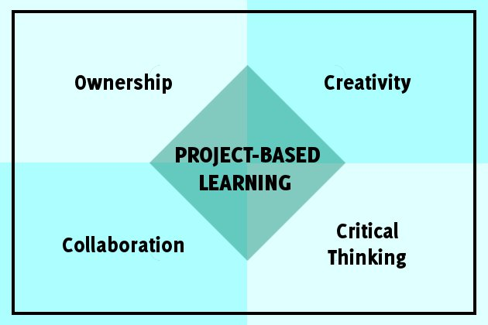
4b. School Projects
Benefits of Project-Based Learning (continued).
Self-Confidence: Students find their voice and learn to take pride in their work, boosting their agency and purpose.
Critical Thinking: Students learn to look at problems with a critical thinking lens, asking questions and coming up with possible solutions for their project.
Perseverance: In working on a project, students learn to manage obstacles more effectively, often learning from failure and possibly starting over from scratch.
Project Management: Students learn how to manage projects and assignments more efficiently.
Curiosity: Students get to explore their curiosities, ask questions and form a new love for learning.
Empowerment: Students take ownership over their projects, reflecting on and celebrating their progress and accomplishments.

Slide 22
Requirement 5
Do ONE of the following:
Write a report of 250 to 300 words about how the education you receive in school will be of value to you in the future and how you will continue to educate yourself in the future.
Write a report of 250 to 300 words about two careers that interest you and how specific classes and good scholarship in general will help you achieve your career goals.

Slide 23
5a. Importance of Education
Why Is Education Important?
Provides Stability - Education provides stability in life, and it’s something that no one can ever take away from you. By being well-educated and holding a college degree, you increase your chances for better career opportunities and open up new doors for yourself.
Provides Financial Security - On top of stability, education also provides financial security, especially in today’s society. A good education tends to lead to a higher paying job, as well as provide you with the skills needed to get there.
Needed For Equality - In order for the entire world to really become equal, it needs to start with education. If everyone was provided with the same opportunities to education, then there would be less gaps between social classes. Everyone would be able to have an equal chance at higher paying jobs — not just those that are already well-off.
Allows For Self-Dependency - The importance of education is evident when it comes to being self-dependent. If we are we educated, then it’s something that belongs to us, and only us, allowing us to rely on no one else other than ourselves. It can allow you to not only be financially independent, but also to make your own choices.
Make Your Dreams Come True - If you can dream it, you can achieve it. An education is the most powerful weapon you can possibly have, and with it, you can make all of your dreams come true. There are of course certain exceptions, depending on what you’re aiming for, but generally an education will take you as far as you’re willing to go.

Slide 24
5a. Importance of Education
Why Is Education Important (continued)?
A Safer World - Education is something that’s not only needed on a personal level, but also on a global level, as it’s something that keeps our world safe and makes it a more peaceful place. Education tends to teach people the difference between right and wrong, and can help people stay out of risky situations.
Confidence - Being self-confident is a major part of being successful in life. And what better way to gain that confidence than with an education? Your level of education is often considered a way to prove your knowledge, and it can give you the confidence to express your opinions and speak your mind.
A Part Of Society - In today’s society, having an education is considered a vital part of being accepted by those around you. Having an education is believed to make you a useful part of society, and can make you feel like a contributing member as well.
Economic Growth On A National Level - An educated society is crucial for economic growth. We need people to continue to learn and research in order to constantly stay innovative. Countries with higher literacy rates also tend to be in better economic situations. With a more educated population, more employment opportunities are opened.
Can Protect You - Education can protect you more than you know, not only on a financial level, but it can help prevent you from being taken advantage of by knowing how to read and write, such as knowing not to sign any bogus documents.

Slide 25
5b. Achieving Career Goals
Getting a solid education is an important foundation for any career. Workers in many occupations use problem-solving, communication, research, and other skills that they first learned in high school. By doing well in classes and taking part in career-training or college-preparation programs, you demonstrate that you’re ready to put these skills into action.
Employers and postsecondary schools often look to your high school record to gauge how you might perform on the job or in an educational program.
Understanding what you enjoy—and what you’re good at—is the first step in exploring careers. Use this to identify careers that may have similar tasks.
There are hundreds of occupations, and most of them involve more than one skill area. School counselors, teachers, and parents can help point you in the direction of occupations that match your interests and skills. School counselors often have tools that they use to link interests and skills with careers and can help you identify which courses you will need to take to realize your goals.
Work will eventually be a big part of your life and the whole purpose of thinking about careers now is so that when you go to the workforce, you wake up in the morning and look forward to going to work.

